Slide 1

World Autism Acceptance Month
#InclusionNotExclusion

Slide 2
In our assembly we will…
Share when and what autism acceptance month is
Learn a little about autism
Think about how we can support and celebrate each others' differences

Slide 3
Autism Acceptance Month is …
A CELEBRATION!

Slide 4

When do we celebrate?
Autism acceptance month runs for the whole of April

Slide 5

Why helping each other is important
Everyone is different
Everyone is important
Everyone has a meaningful contribution
In our school, we want to work together to support each other

Slide 6
What is autism?
Check out this link: Amazing Things Happen!

Slide 7

Celebrating each others' differences
Just like one rainbow, we are one school

Slide 8
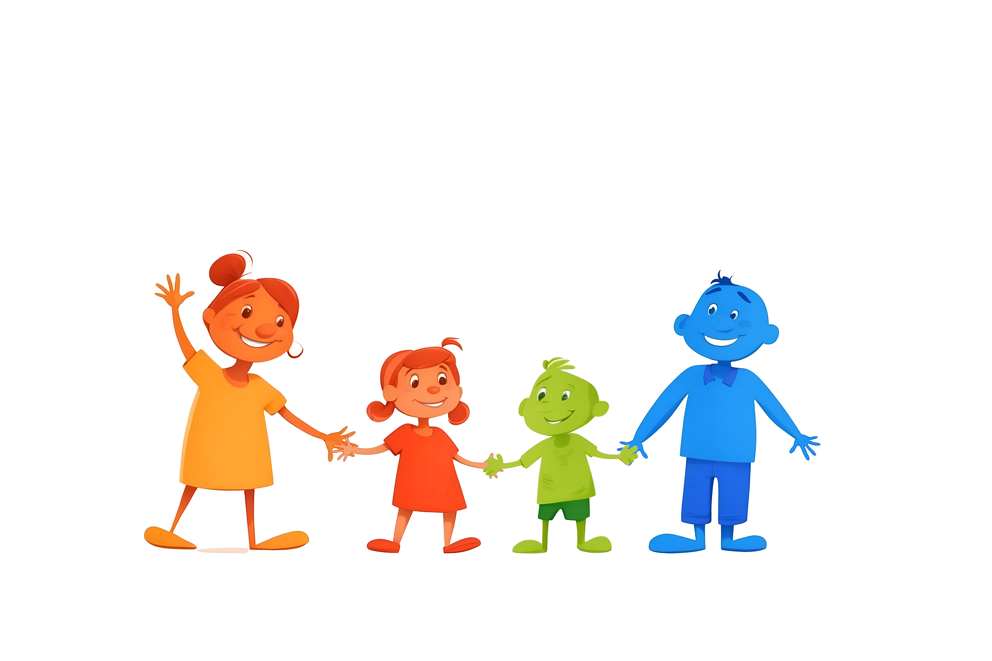
Acceptance is…
Being seen by my peers and teachers

Slide 9

Acceptance is …
Not feeling scared to be myself

Slide 10
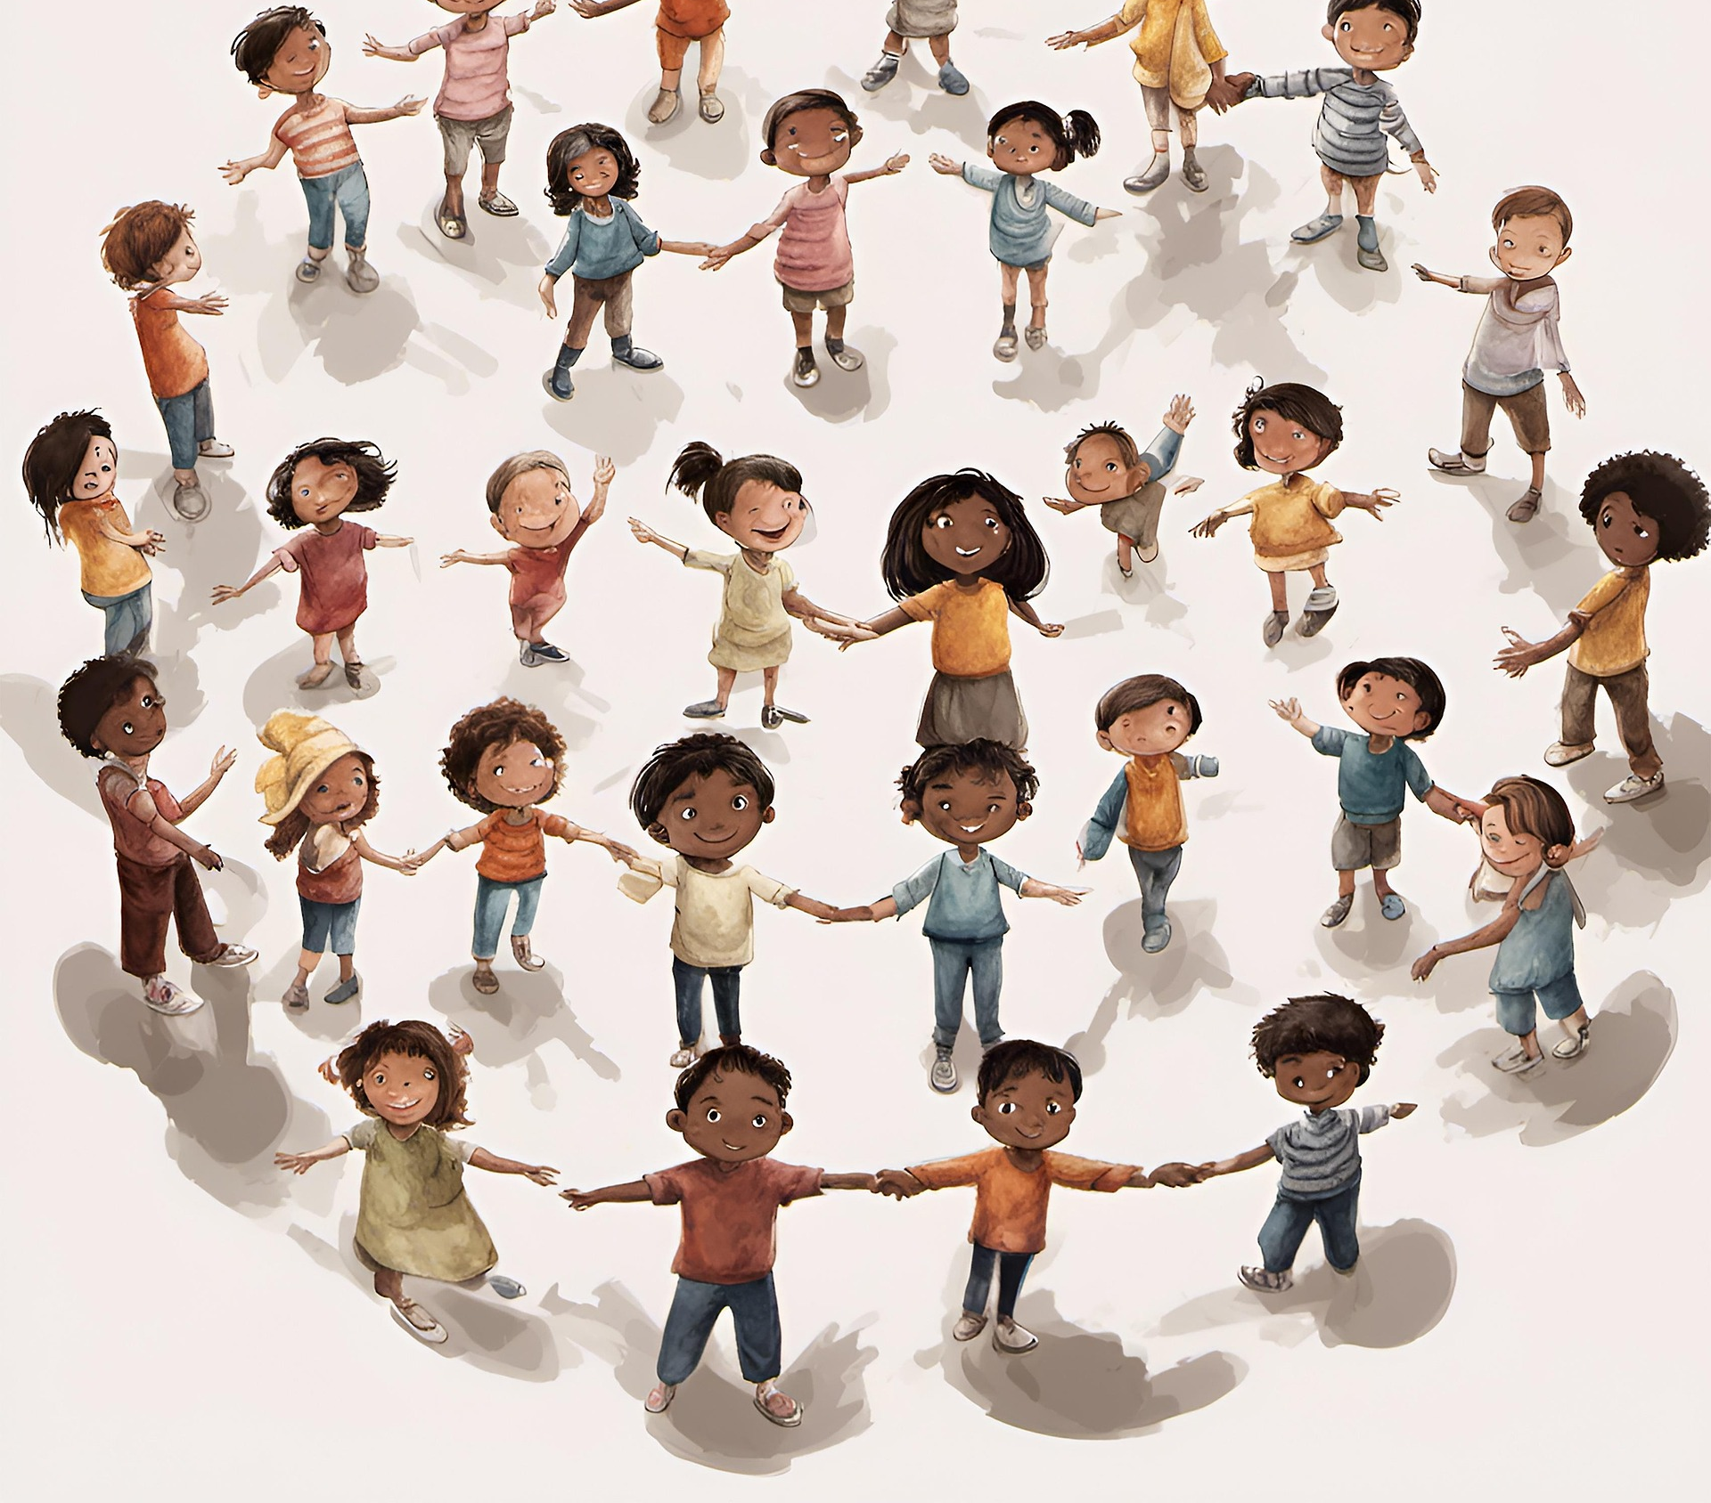
Acceptance is …
Understanding other people

Slide 11

Acceptance is…
Not wanting people to change and just letting everyone be themselves

Slide 12

Acceptance is…
Celebrating everyone’s unique strengths and abilities

Slide 13
How can we celebrate each other?

Slide 14

How can we support each other
Being understanding when others are different to us
Accepting every one's strengths
Getting to know each other better
Smiling and saying hello
Accepting that we all interact in different ways

